Slide 1
Analysis of a cohort of Major Depressive Disorder (MDD) with Regularized Generalized Canonical Correlation Analysis (RGCCA)
Encadrants
Arnaud Gloaguen
Jimmy Vandel
1
Notes:
Rajouter logo Pasteur + vlg + labos

Slide 2
1. Introduction of the case study

Slide 3
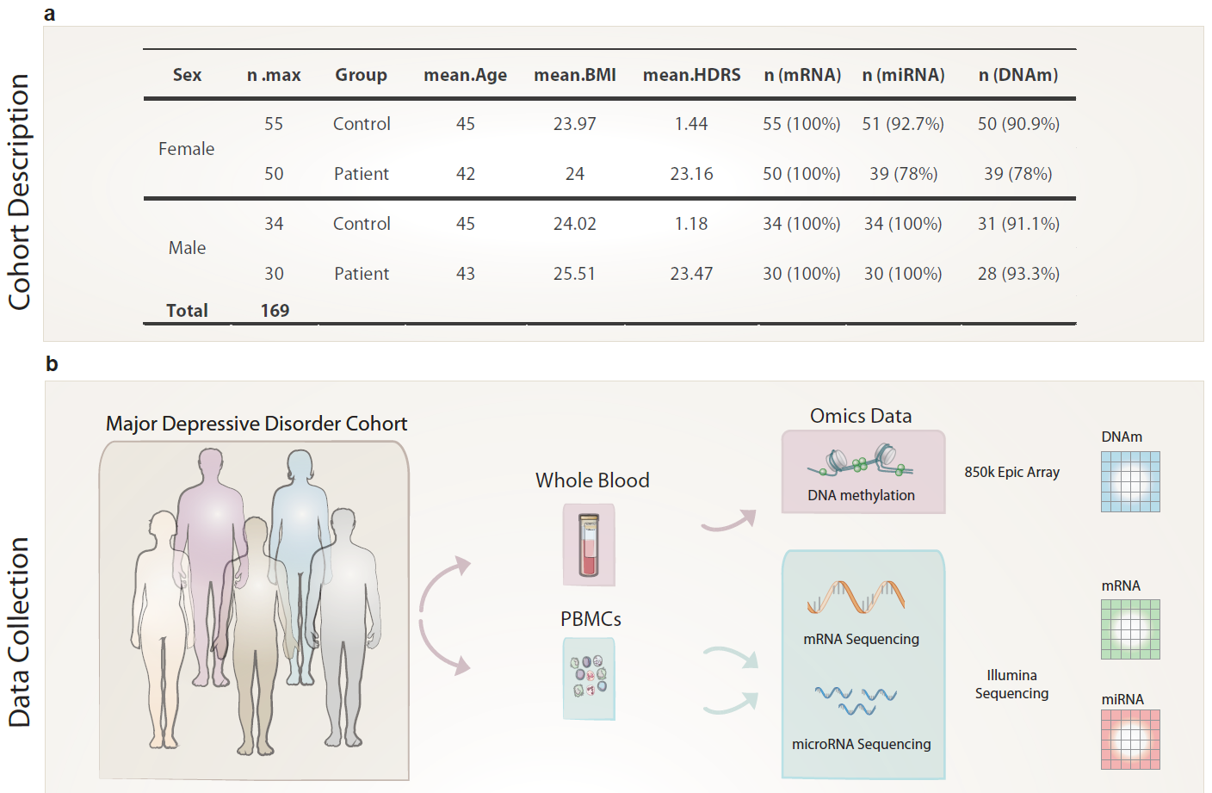



Case Study: Major Depressive Disorder (MDD)
Data
Unsupervised/1-block
Unsup./2-blocks
Supervised/2-blocks
Unsup./$L$-blocks
Supervised/$L$-blocks
Further

Slide 4
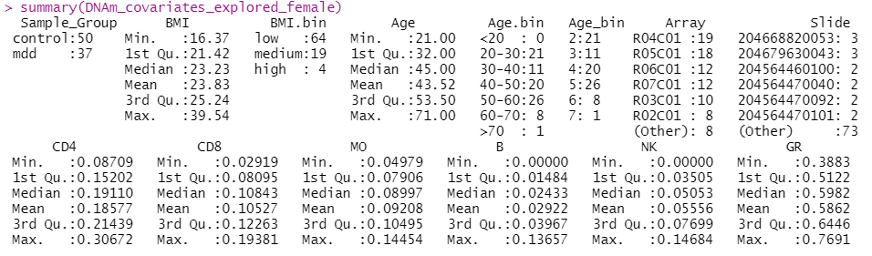

Case Study: Covariates
Low ($≤25)$, High ($≥30$).
Relative to position on the DNAm chip.
Relative to blood cell composition (T cells subsets, monocytes, B cells, NK cells and granulocytes) inferred from DNAm.
Data
Unsupervised/1-block
Unsup./2-blocks
Supervised/2-blocks
Unsup./$L$-blocks
Supervised/$L$-blocks
Further
Unsup./$L$-blocks

Slide 5
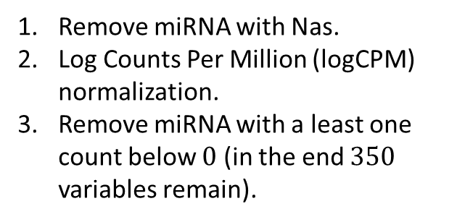
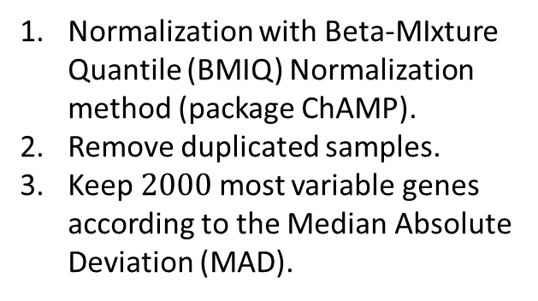
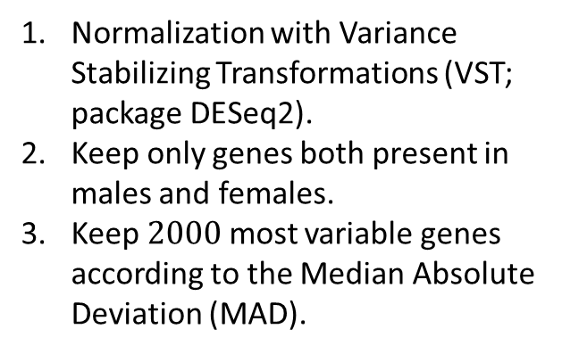
Case Study: Pre-processing
Remove miRNA with Nas.
Log Counts Per Million (logCPM) normalization.
Remove miRNA with a least one count below $0$ (in the end $350$ variables remain).
Normalization with Variance Stabilizing Transformations (VST; package DESeq2).
Keep only genes both present in males and females.
Keep $2000$ most variable genes according to the Median Absolute Deviation (MAD).
Normalization with Beta-MIxture Quantile (BMIQ) Normalization method (package ChAMP).
Remove duplicated samples.
Keep $2000$ most variable genes according to the Median Absolute Deviation (MAD).
Finally: individuals common to ALL omics data are kept.
$MAD =median\left(\left|x_{i}−median\left(x\right)\right|\right)$, it is a robust estimation of the standard deviation.
Data
Unsupervised/1-block
Unsup./2-blocks
Supervised/2-blocks
Unsup./$L$-blocks
Supervised/$L$-blocks
Further
Unsup./$L$-blocks

Slide 6
2. Unsupervised analysis with one-block

Slide 7


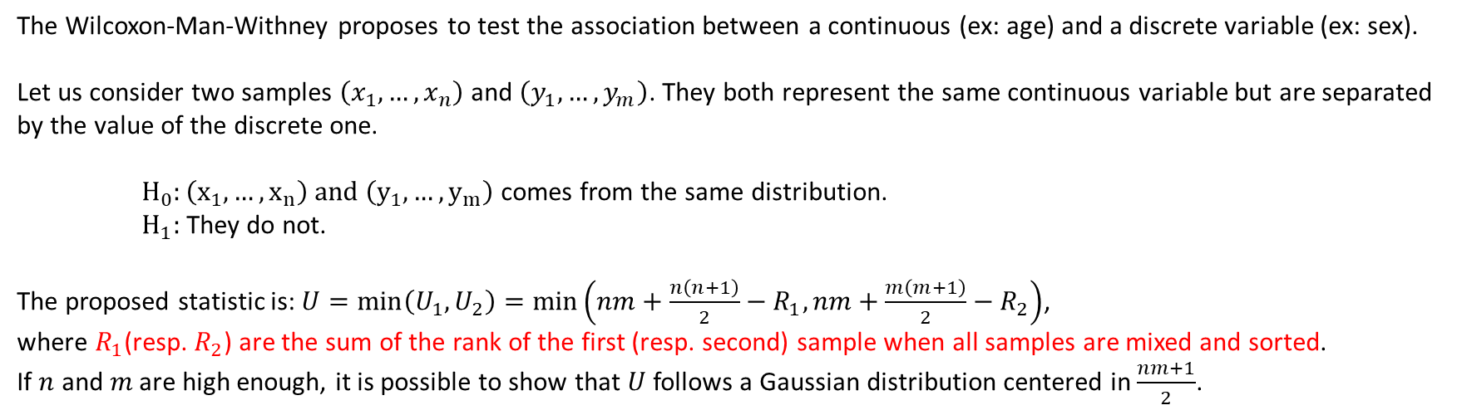


ChAMP’s representation: Kruskal-Wallis test
The Kruskal-Wallis test is a generalization of the Wilcoxon-Man-Withney test that works for two samples.
They are both non-parametric.
The Wilcoxon-Man-Withney proposes to test the association between a continuous (ex: age) and a discrete variable (ex: sex).
Let us consider two samples $\left(x_{1},…,x_{n}\right)$ and $\left(y_{1},…,y_{m}\right)$. They both represent the same continuous variable but are separated by the value of the discrete one.
$H_{0}:\left(x_{1},…,x_{n}\right) \text{and} \left(y_{1},…,y_{m}\right)$ comes from the same distribution.
$H_{1}:$ They do not.
The proposed statistic is: $U=\min\left(U_{1}, U_{2}\right)=\min\left(nm+\frac{n\left(n+1\right)}{2}−R_{1},nm+\frac{m\left(m+1\right)}{2}−R_{2}\right)$, where $R_{1}$(resp. $R_{2}$) are the sum of the rank of the first (resp. second) sample when all samples are mixed and sorted.
If $n$ and $m$ are high enough, it is possible to show that $U$ follows a Gaussian distribution centered in $\frac{nm+1}{2}$.
Example: “Perfect” association; the $n$ first elements are in the first sample and the $m$ next are in the second one. Then:
$$R_{1}=1+2+…+n=\frac{n\left(n+1\right)}{2}$$
➔ $U_{1}=nm+\frac{n\left(n+1\right)}{2}−R_{1}=nm$
$$R_{2}=\left(n+1\right)+\left(n+2\right)+…+(n+m)=\frac{m\left((n+1)+(n+m)\right)}{2}$$
➔ $U=0$
➔ $U_{2}=nm+\frac{m\left(m+1\right)}{2}−R_{2}=0$
The test is likely to be rejected.
Data
Unsupervised/1-block
Unsup./2-blocks
Supervised/2-blocks
Unsup./$L$-blocks
Supervised/$L$-blocks
Further
Unsup./$L$-blocks

Slide 8


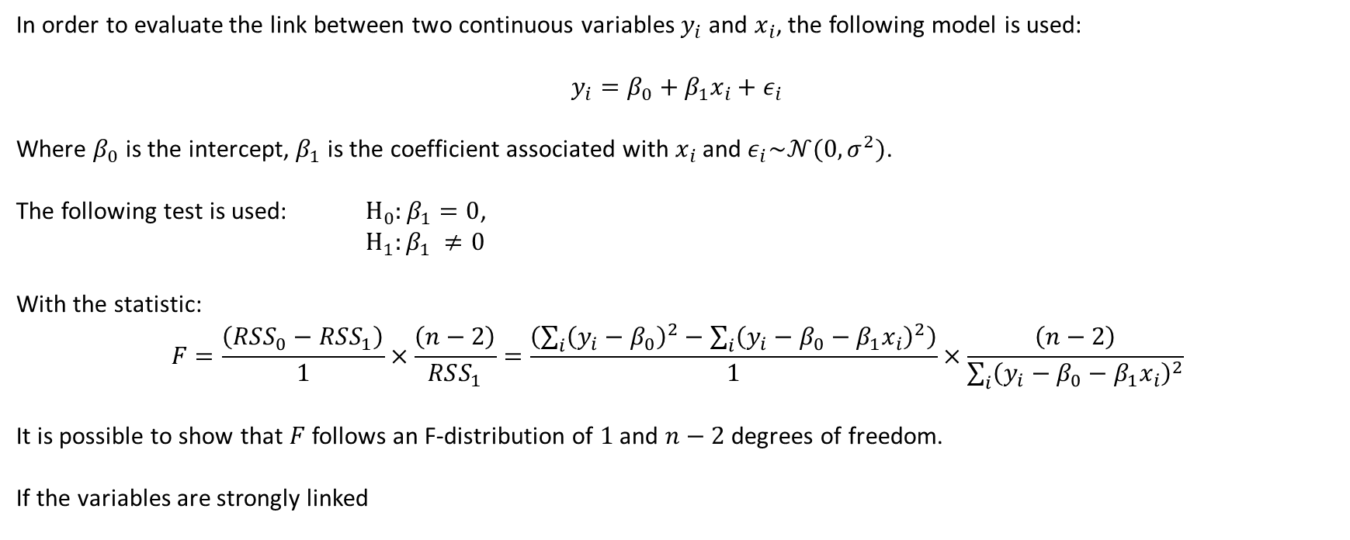


ChAMP’s representation: F-test
In order to evaluate the link between two continuous variables $y_{i}$ and $x_{i}$, the following model is used:
$$y_{i}=β_{0}+β_{1}x_{i}+ε_{i}$$
Where $β_{0}$ is the intercept, $β_{1}$ is the coefficient associated with $x_{i}$ and $ε_{i}\sim 𝒩(0, σ^{2})$.
The following test is used: $H_{0}:β_{1}=0$,
$H_{1}:β_{1} ≠0$
With the statistic:
$$F=\frac{\left(RSS_{0}−RSS_{1}\right)}{1}×\frac{\left(n−2\right)}{RSS_{1}}=\frac{\left(\sum_{i}{{\left(y_{i}−β_{0}\right)}^{2}}−\sum_{i}{{\left(y_{i}−β_{0}−β_{1}x_{i}\right)}^{2}}\right)}{1}×\frac{\left(n−2\right)}{\sum_{i}{{\left(y_{i}−β_{0}−β_{1}x_{i}\right)}^{2}}}$$
It is possible to show that $F$ follows an F-distribution of $1$ and $n−2$ degrees of freedom.
If the variables are strongly linked
➔$RSS_{0}≫RSS_{1}$
➔ $F\sim \frac{RSS_{0}}{RSS_{1}}×\left(n−2\right)≫n−2$
➔ The test is likely to be rejected.
If the variables are NOT strongly linked
➔$RSS_{0}\sim RSS_{1}$
➔ $F\sim 0$
➔ The test is likely to be accepted.
Data
Unsupervised/1-block
Unsup./2-blocks
Supervised/2-blocks
Unsup./$L$-blocks
Supervised/$L$-blocks
Further
Unsup./$L$-blocks

Slide 9
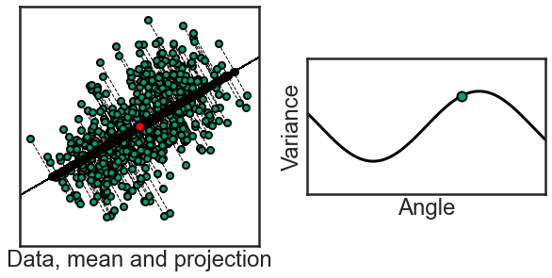
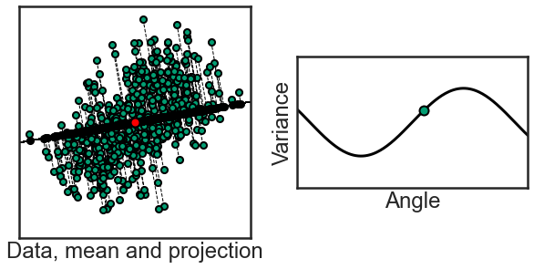
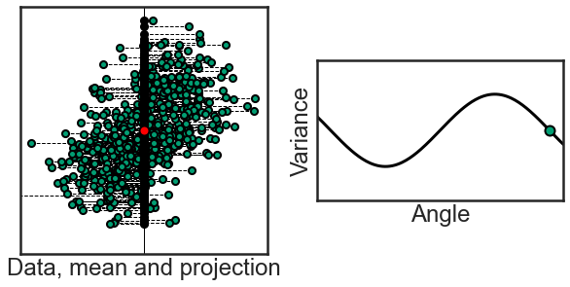
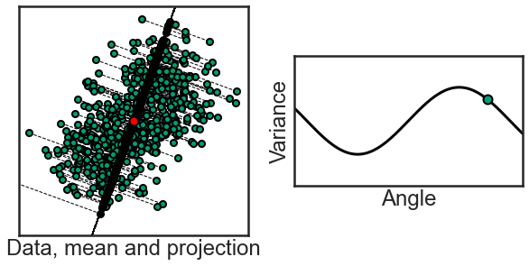
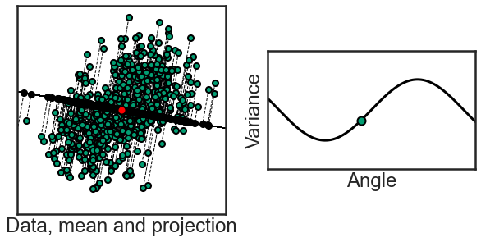
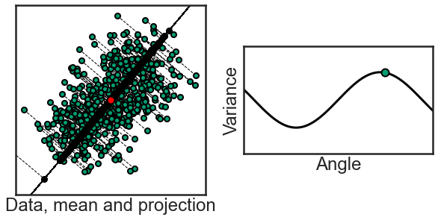
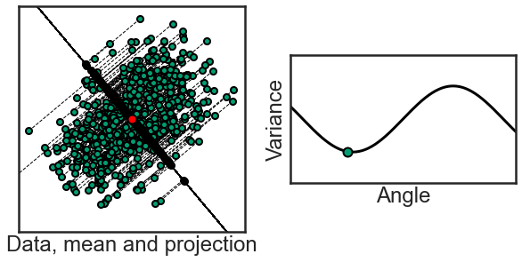
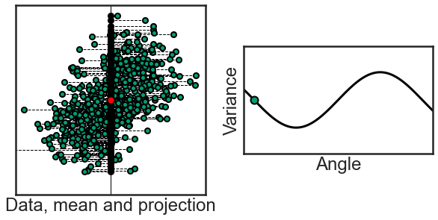
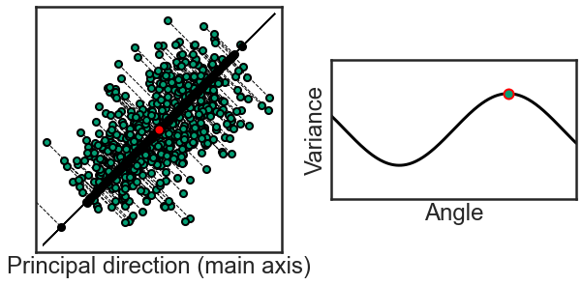
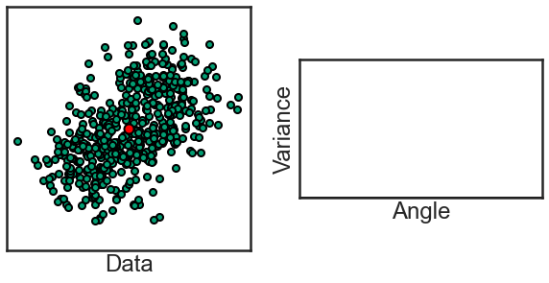
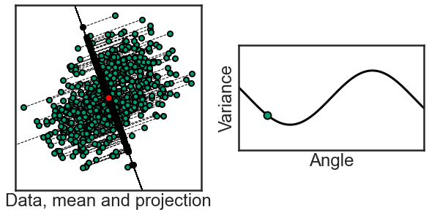
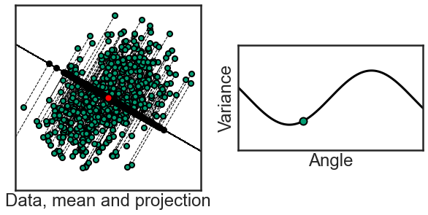
Principle of Principal Component Analysis (PCA)
How can we estimate this projection ?
Data
Unsupervised/1-block
Unsup./2-blocks
Supervised/2-blocks
Unsup./$L$-blocks
Supervised/$L$-blocks
Further
Unsup./$L$-blocks

Slide 10


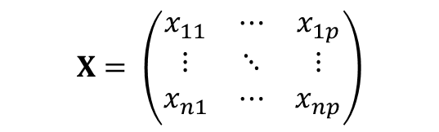
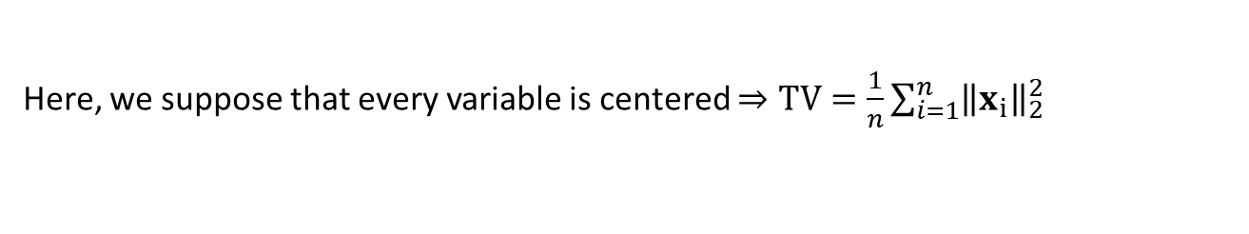

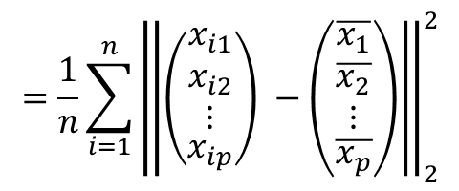
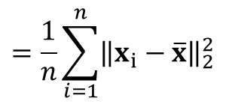

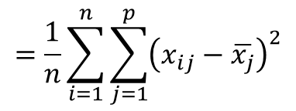
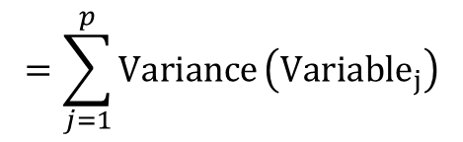
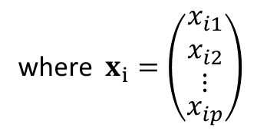
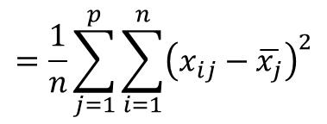
Total Variance
$n$ individuals/subjects
$p$ variables
$$=\left(\begin{aligned}\begin{matrix}x_{1}^{⊤} \\ x_{2}^{⊤} \\ ⋮\end{matrix} \\ x_{n}^{⊤}\end{aligned}\right)$$
where $x_{i}=\left(\begin{aligned}\begin{matrix}x_{i1} \\ x_{i2} \\ ⋮\end{matrix} \\ x_{ip}\end{aligned}\right)$
$$X= \left(\begin{matrix}x_{11} & ⋯ & x_{1p} \\ ⋮ & ⋱ & ⋮ \\ x_{n1} & ⋯ & x_{np}\end{matrix}\right)$$
$$=\sum_{j=1}^{p}{Variance}\left(Variable_{j}\right)$$
$$=\frac{1}{n}\sum_{j=1}^{p}{\sum_{i=1}^{n}{{\left(x_{ij}−\overline{x_{j}}\right)}^{2}}}$$
$$=\frac{1}{n}\sum_{i=1}^{n}{\sum_{j=1}^{p}{{\left(x_{ij}−\overline{x_{j}}\right)}^{2}}}$$
$$Total Variance (TV)$$
$$=\frac{1}{n}\sum_{i=1}^{n}{{\left\|\left(\begin{aligned}\begin{matrix}x_{i1} \\ x_{i2} \\ ⋮\end{matrix} \\ x_{ip}\end{aligned}\right) −\left(\begin{aligned}\begin{matrix}\overline{x_{1}} \\ \overline{x_{2}} \\ ⋮\end{matrix} \\ \overline{x_{p}}\end{aligned}\right)\right\|}_{2}^{2}}$$
$$=\frac{1}{n}\sum_{i=1}^{n}{{\left\|x_{i}−\overline{x}\right\|}_{2}^{2}}$$
Here, we suppose that every variable is centered $⇒TV=\frac{1}{n}\sum_{i=1}^{n}{{\left\|x_{i}\right\|}_{2}^{2}}$
Data
Unsupervised/1-block
Unsup./2-blocks
Supervised/2-blocks
Unsup./$L$-blocks
Supervised/$L$-blocks
Further
Unsup./$L$-blocks

Slide 11
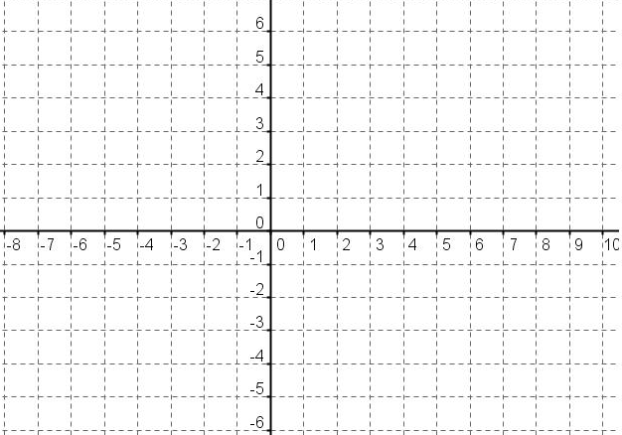



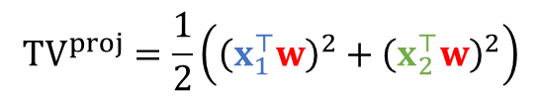
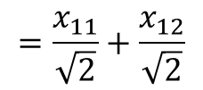


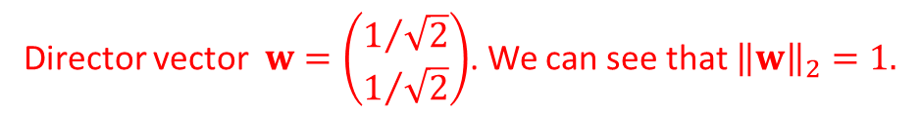
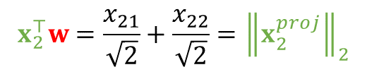

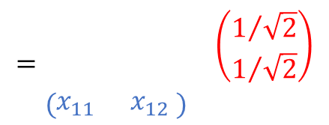
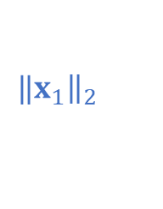
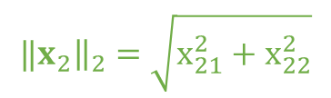




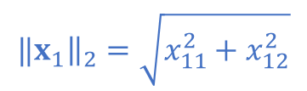


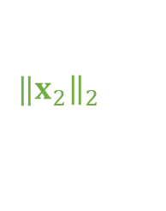
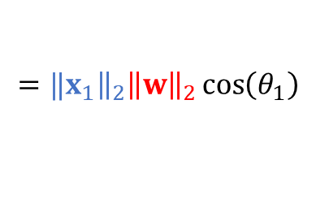

Total Variance – Example in 2D
$${‖x}_{1}{\left.​\right\|}_{2}=\sqrt{x_{11}^{2}+x_{12}^{2}}$$
$${‖x}_{2}{\left.​\right\|}_{2}=\sqrt{x_{21}^{2}+x_{22}^{2}}$$
Director vector $w=\left(\begin{aligned}1/{\sqrt{2}} \\ 1/{\sqrt{2}}\end{aligned}\right)$. We can see that ${\left\|w\right\|}_{2}=1.$
$${\left\|x_{1}^{proj}\right\|}_{2}$$
$$x_{2}=\left(\begin{matrix}2 \\ −6\end{matrix}\right)$$
$$x_{1}=\left(\begin{matrix}6 \\ 3\end{matrix}\right)$$
$$=\begin{matrix} & \left(\begin{aligned}1/{\sqrt{2}} \\ 1/{\sqrt{2}}\end{aligned}\right) \\ \left(\begin{matrix}x_{11} & x_{12} \end{matrix}\right) & \end{matrix}$$
$$x_{12}$$
$$θ_{1}$$
$$=\frac{x_{11}}{\sqrt{2}}+\frac{x_{12}}{\sqrt{2}}$$
$$x_{22}$$
$$x_{1}^{⊤}w$$
$${‖x}_{2}{\left.​\right\|}_{2}$$
$${‖x}_{1}{\left.​\right\|}_{2}$$
$$θ_{2}$$
$$x_{11}$$
$$x_{21}$$
$$={‖x}_{1}{\left.​\right\|}_{2}{\left\|w\right\|}_{2}\cos\left(θ_{1}\right)$$
$$={‖x}_{1}{\left.​\right\|}_{2}\cos\left(θ_{1}\right)$$
$$={\left\|x_{1}^{proj}\right\|}_{2}$$
$${\left\|x_{2}^{proj}\right\|}_{2}$$
Similarly:
$$x_{2}^{⊤}w=\frac{x_{21}}{\sqrt{2}}+\frac{x_{22}}{\sqrt{2}}={\left\|x_{2}^{proj}\right\|}_{2}$$
In the end:
$${TV}^{proj}=\frac{1}{2}\left({\left(x_{1}^{⊤}w\right)}^{2}+{\left(x_{2}^{⊤}w\right)}^{2}\right)$$
Data
Unsupervised/1-block
Unsup./2-blocks
Supervised/2-blocks
Unsup./$L$-blocks
Supervised/$L$-blocks
Further
Unsup./$L$-blocks

Slide 12
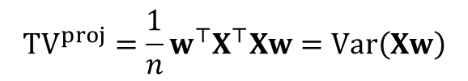
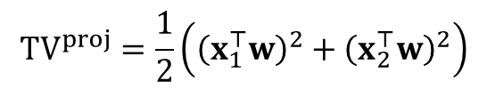

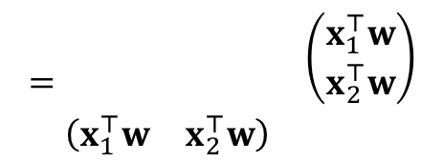
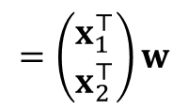
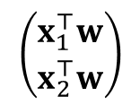
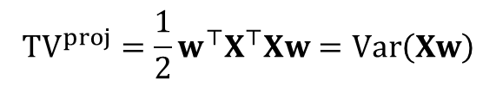
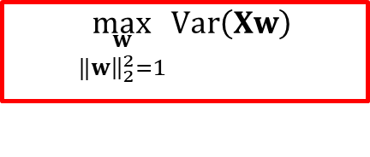
PCA optimization criterion
$$=\begin{matrix} & \left(\begin{aligned}x_{1}^{⊤}w \\ x_{2}^{⊤}w\end{aligned}\right) \\ \left(\begin{matrix}x_{1}^{⊤}w & x_{2}^{⊤}w\end{matrix}\right) & \end{matrix}$$
$$\left(\begin{aligned}x_{1}^{⊤}w \\ x_{2}^{⊤}w\end{aligned}\right)$$
$$=\left(\begin{aligned}x_{1}^{⊤} \\ x_{2}^{⊤}\end{aligned}\right)w$$
$${TV}^{proj}=\frac{1}{2}\left({\left(x_{1}^{⊤}w\right)}^{2}+{\left(x_{2}^{⊤}w\right)}^{2}\right)$$
By the way:
$$=Xw$$
Hence:
$${TV}^{proj}=\frac{1}{2}{w^{⊤}X}^{⊤}Xw=Var\left(Xw\right)$$
$${TV}^{proj}=\frac{1}{n}{w^{⊤}X}^{⊤}Xw=Var\left(Xw\right)$$
It is possible to show in the general case that:
Hence, one possible optimization criterion in order to estimate the first principal direction is:
$$\max_{\begin{aligned}w \\ ‖{w\left.​\right\|}_{2}^{2}=1\end{aligned}}{Var\left(Xw\right)}$$
Data
Unsupervised/1-block
Unsup./2-blocks
Supervised/2-blocks
Unsup./$L$-blocks
Supervised/$L$-blocks
Further
Unsup./$L$-blocks

Slide 13
3. Unsupervised analysis with two-blocks

Slide 14



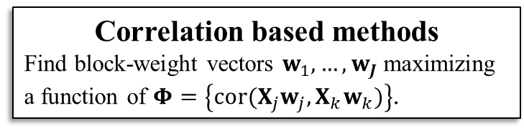
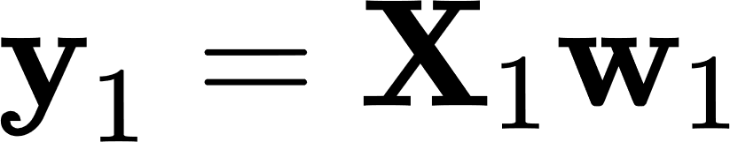
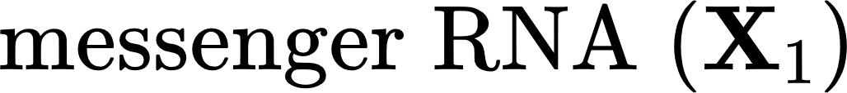








The philosophy of multiblock component methods
block
components
block
weight-vectors
…
Block components should verified two properties at the same time:
Block components well explain their own block.
Block components are as correlated as possible for connected blocks.
…
Data
Unsupervised/1-block
Unsup./2-blocks
Supervised/2-blocks
Unsup./$L$-blocks
Supervised/$L$-blocks
Further
Unsup./$L$-blocks

Slide 15











From PCA to PLS/CCA
Canonical Correlation Analysis (CCA)
Partial Least Squares (PLS2)
$$\max_{\begin{aligned}w_{1},w_{2} \\ Var\left(X_{i}w_{i}\right)=1\end{aligned}}{Cov\left(X_{1}w_{1},X_{2}w_{2}\right)}$$
$$\max_{\begin{aligned}w_{1},w_{2} \\ ‖{w_{i}\left.​\right\|}_{2}^{2}=1\end{aligned}}{Cov\left(X_{1}w_{1},X_{2}w_{2}\right)}$$
Principal Component Analysis (PCA)
$$\max_{\begin{aligned}w_{1},w_{2} \\ ‖{w_{i}\left.​\right\|}_{2}^{2}= 1\end{aligned}}{\sqrt{Var\left(X_{1}w_{1}\right)}}Cor\left(X_{1}w_{1},X_{2}w_{2}\right)\sqrt{Var\left(X_{2}w_{2}\right)}$$
$$=\max_{\begin{aligned}w_{1},w_{2} \\ Var\left(X_{i}w_{i}\right)= 1\end{aligned}}{Cor\left(X_{1}w_{1},X_{2}w_{2}\right)}$$
$$\max_{\begin{aligned}w_{1},w_{2} \\ ‖{w_{i}\left.​\right\|}_{2}^{2}= 1\end{aligned}}{Var\left(X_{1}w_{1}\right)}Cor\left(X_{1}w_{1},X_{2}w_{2}\right)Var\left(X_{2}w_{2}\right)$$
$$\max_{\begin{aligned}w \\ ‖{w\left.​\right\|}_{2}^{2}=1\end{aligned}}{Var\left(Xw\right)}$$
$$\max_{\begin{aligned}w_{1},w_{2} \\ ‖{w_{i}\left.​\right\|}_{2}^{2}= 1\end{aligned}}{Var\left(X_{1}w_{1}\right)}Var\left(X_{2}w_{2}\right)$$
$$\max_{\begin{aligned}w_{1},w_{2} \\ ‖{w_{i}\left.​\right\|}_{2}^{2}= 1\end{aligned}}{Var\left(X_{1}w_{1}\right)}Cor\left(X_{1}w_{1},X_{2}w_{2}\right)Var\left(X_{2}w_{2}\right)$$
$$\max_{\begin{aligned}w_{1},w_{2} \\ Var\left(X_{i}w_{i}\right)= 1\end{aligned}}{Cov\left(X_{1}w_{1},X_{2}w_{2}\right)}$$
$$\max_{\begin{aligned}w_{1},w_{2} \\ ‖{w_{i}\left.​\right\|}_{2}^{2}= 1\end{aligned}}{Cov\left(X_{1}w_{1},X_{2}w_{2}\right)}$$
$$Cov\left(X_{1}w_{1},X_{2}w_{2}\right)$$
Data
Unsupervised/1-block
Unsup./2-blocks
Supervised/2-blocks
Unsup./$L$-blocks
Supervised/$L$-blocks
Further
Unsup./$L$-blocks

Slide 16











PLS & CCA with a figure
$$\left[x_{1} x_{2}\right]\sim 𝒩\left(\left(0,0\right), \left(\begin{matrix}1 & 0.5 \\ 0.5 & 1\end{matrix}\right)\right)$$
$${\left(z\right)}_{i}=\left\{\begin{aligned}0{ if \left(x\right)}_{i}<0 \\ 1 otherwise\end{aligned}\right.$$
$$x_{1}$$
$$x_{2}$$
$$z$$
$$y_{1}=w_{11}x_{1}+w_{12}x_{2}$$
$$y_{2}∝z$$
$$y_{PCA}∝\frac{1}{2}x_{1}+\frac{1}{2}x_{2}$$
$$y_{PLS}∝\frac{2}{3}x_{1}+\frac{1}{3}x_{2}$$
$$y_{CCA}∝x_{1}$$
Data
Unsupervised/1-block
Unsup./2-blocks
Supervised/2-blocks
Unsup./$L$-blocks
Supervised/$L$-blocks
Further
Unsup./$L$-blocks

Slide 17



Two-blocks special cases: PLS & CCA
… and Regularized-CCA
Canonical Correlation Analysis (CCA)
Partial Least Squares (PLS2)
$$\max_{\begin{aligned}w_{1},w_{2} \\ Var\left(X_{i}w_{i}\right)=1\end{aligned}}{Cov\left(X_{1}w_{1},X_{2}w_{2}\right)}$$
$$\max_{\begin{aligned}w_{1},w_{2} \\ ‖{w_{i}\left.​\right\|}_{2}^{2}=1\end{aligned}}{Cov\left(X_{1}w_{1},X_{2}w_{2}\right)}$$
Regularized-CCA
$$\max_{w_{1},w_{2}}{Cov\left(X_{1}w_{1},X_{2}w_{2}\right)}$$
$$s.t. \left(1−τ_{i}\right)Var\left(X_{i}w_{i}\right)+τ_{i}‖{w_{i}\left.​\right\|}_{2}^{2}=1.$$
Data
Unsupervised/1-block
Unsup./2-blocks
Supervised/2-blocks
Unsup./$L$-blocks
Supervised/$L$-blocks
Further
Unsup./$L$-blocks

Slide 18
PLS & CCA with a figure
$$\left[x_{1} x_{2}\right]\sim 𝒩\left(\left(0,0\right), \left(\begin{matrix}1 & 0.5 \\ 0.5 & 1\end{matrix}\right)\right)$$
$${\left(z\right)}_{i}=\left\{\begin{aligned}0{ if \left(x\right)}_{i}<0 \\ 1 otherwise\end{aligned}\right.$$
$$x_{1}$$
$$x_{2}$$
$$z$$
$$y_{1}=w_{11}x_{1}+w_{12}x_{2}$$
$$y_{2}∝z$$
$$y_{PCA}∝\frac{1}{2}x_{1}+\frac{1}{2}x_{2}$$
$$y_{PLS}∝\frac{2}{3}x_{1}+\frac{1}{3}x_{2}$$
$$y_{CCA}∝x_{1}$$
R-CCA
Data
Unsupervised/1-block
Unsup./2-blocks
Supervised/2-blocks
Unsup./$L$-blocks
Supervised/$L$-blocks
Further

Slide 19

4. Unsupervised analysis with $L$-blocks

Slide 20



















Regularized Generalized Canonical Correlation Analysis (RGCCA)
$$X_{1}$$
$$X_{2}$$
$$X_{L}$$
$$c_{1L}$$
$$c_{1l}$$
$$c_{lL}$$
$$\max_{w_{1},{…, w}_{L}}{\sum_{k,l=1}^{L}{c_{kl} g\left|Cov\left(X_{k}w_{k},X_{l}w_{l}\right)\right|}}$$
$$\max_{w_{1},{…, w}_{L}}{\sum_{k,l=1}^{L}{c_{kl} g\left(Cov\left(X_{k}w_{k},X_{l}w_{l}\right)\right)}}$$
$$\max_{w_{1},{…, w}_{L}}{\sum_{k,l=1}^{L}{c_{kl} g{\left(Cov\left(X_{k}w_{k},X_{l}w_{l}\right)\right)}^{2}}}$$
$$\max_{w_{1},{…, w}_{L}}{\sum_{k,l=1}^{L}{c_{kl} g\left(Cov\left(X_{k}w_{k},X_{l}w_{l}\right)\right)}}$$
$$X_{l}$$
$$\max_{w_{1},{…, w}_{L}}{\sum_{k,l=1}^{L}{c_{kl} g\left(Cov\left(X_{k}w_{k},X_{l}w_{l}\right)\right)}}$$
$$\max_{w_{1},w_{2}}{Cov\left(X_{1}w_{1},X_{2}w_{2}\right)}$$
$$s.t.w_{l}^{⊤}X_{l}^{⊤}X_{l}w_{l}=I, l=1, 2.$$
$$s.t. w_{l}^{⊤}M_{l}w_{l}=1, l=1, 2.$$
$s.t.w_{l}^{⊤}M_{l}w_{l}=1, l=1, …, L$.
$$s.t.{\left\|w_{l}\right\|}_{2}^{2}=1, l=1, 2.$$
where $M_{l}$is any $J_{l}×J_{l}$ positive definite matrix
Partial Least Squares 2
Data
Unsupervised/1-block
Unsup./2-blocks
Supervised/2-blocks
Unsup./2-blocks
Unsup./$L$-blocks
Supervised/$L$-blocks
Further

Slide 21






Summary of RGCCA
The Regularized Generalized Canonical Correlation Analysis (RGCCA) Optimization criterion :
$$\max_{w_{1},{…, w}_{L}}{\sum_{k,l=1}^{L}{c_{kl} g\left(Cov\left(X_{k}w_{k},X_{l}w_{l}\right)\right)}}$$
$s.t.w_{l}^{⊤}M_{l}w_{l}=1, l=1, …, L$.
With “$g$” a continuous, convex and derivable function.
$c_{lk}=1$ for two connected blocks and $0$ otherwise.
Where $M_{l}$ is any $J_{l}×J_{l}$ positive definite matrix.
Most of the time (this is the case today !) $M_{l}$ is chosen such that:
$$w_{l}^{⊤}M_{l}w_{l}= \left(1−τ_{l}\right)Var\left(X_{l}w_{l}\right)+τ_{l}‖{w_{l}\left.​\right\|}_{2}^{2} =1.$$
$${= w}_{l}^{⊤}\left(\left(1−τ_{l}\right)I^{−1}X_{l}^{⊤}X_{l}+τ_{l}I_{J_{l}}\right)w_{l} =$$
$$= \left(1−τ_{l}\right)Var\left(X_{l}w_{l}\right)+τ_{l}‖{w_{l}\left.​\right\|}_{2}^{2} =$$
Regularized version of the sample covariance matrix
Data
Unsupervised/1-block
Unsup./2-blocks
Supervised/2-blocks
Unsup./2-blocks
Unsup./$L$-blocks
Supervised/$L$-blocks
Further

Slide 22



Overview of the Multi-Block litterature
X₁
X₁
X₂
X₂
X₃
X₃
X_{J}
X_{J}
Data
Unsupervised/1-block
Unsup./2-blocks
Supervised/2-blocks
Unsup./2-blocks
Unsup./$L$-blocks
Supervised/$L$-blocks
Further

Slide 23




















Tune parameters in an unsupervised setting
$${mRNA}_{1}$$
$$…$$
$${mRNA}_{J_{1}}$$
$${DNAm}_{1}$$
$$…$$
$$…$$
$${DNAm}_{J_{2}}$$
$$…$$
$${miRNA}_{J_{3}}$$
$${miRNA}_{1}$$
$$subj_{1}$$
$$subj_{2}$$
$$subj_{3}$$
$$mRNA \left(X_{1}\right)$$
$$DNAm \left(X_{2}\right)$$
$$miRNA$$
$$\left(X_{3}\right)$$
$$I$$
$$subj_{4}$$
$$subj_{5}$$
$$subj_{6}$$
Data
Unsupervised/1-block
Unsup./2-blocks
Supervised/2-blocks
Unsup./2-blocks
Unsup./$L$-blocks
Supervised/$L$-blocks
Further

Slide 24



Tune parameters in an unsupervised setting
$${mRNA}_{1}$$
$$…$$
$${mRNA}_{J_{1}}$$
$${DNAm}_{1}$$
$$…$$
$$…$$
$${DNAm}_{J_{2}}$$
$$…$$
$${miRNA}_{J_{3}}$$
$${miRNA}_{1}$$
$$mRNA \left(X_{1}\right)$$
$$DNAm \left(X_{2}\right)$$
$$miRNA$$
$$\left(X_{3}\right)$$
Permutation n°1
Parameter set n°$1$
Frequency
RGCCA’s criterion
$$…$$
$$…$$
Parameter set n°$K$
Frequency
RGCCA’s criterion
Data
Unsupervised/1-block
Unsup./2-blocks
Supervised/2-blocks
Unsup./2-blocks
Unsup./$L$-blocks
Supervised/$L$-blocks
Further

Slide 25
Tune parameters in an unsupervised setting
$${mRNA}_{1}$$
$$…$$
$${mRNA}_{J_{1}}$$
$${DNAm}_{1}$$
$$…$$
$$…$$
$${DNAm}_{J_{2}}$$
$$…$$
$${miRNA}_{J_{3}}$$
$${miRNA}_{1}$$
$$mRNA \left(X_{1}\right)$$
$$DNAm \left(X_{2}\right)$$
$$miRNA$$
$$\left(X_{3}\right)$$
Permutation n°2
Parameter set n°$1$
Frequency
RGCCA’s criterion
$$…$$
$$…$$
Parameter set n°$K$
Frequency
RGCCA’s criterion
Data
Unsupervised/1-block
Unsup./2-blocks
Supervised/2-blocks
Unsup./2-blocks
Unsup./$L$-blocks
Supervised/$L$-blocks
Further

Slide 26

Tune parameters in an unsupervised setting
$${mRNA}_{1}$$
$$…$$
$${mRNA}_{J_{1}}$$
$${DNAm}_{1}$$
$$…$$
$$…$$
$${DNAm}_{J_{2}}$$
$$…$$
$${miRNA}_{J_{3}}$$
$${miRNA}_{1}$$
$$mRNA \left(X_{1}\right)$$
$$DNAm \left(X_{2}\right)$$
$$miRNA$$
$$\left(X_{3}\right)$$
Permutation n°$N$
Parameter set n°$1$
Frequency
RGCCA’s criterion
$$…$$
$$…$$
Parameter set n°$K$
Frequency
RGCCA’s criterion
Data
Unsupervised/1-block
Unsup./2-blocks
Supervised/2-blocks
Unsup./2-blocks
Unsup./$L$-blocks
Supervised/$L$-blocks
Further

Slide 27
Tune parameters in an unsupervised setting
$${mRNA}_{1}$$
$$…$$
$${mRNA}_{J_{1}}$$
$${DNAm}_{1}$$
$$…$$
$$…$$
$${DNAm}_{J_{2}}$$
$$…$$
$${miRNA}_{J_{3}}$$
$${miRNA}_{1}$$
$$subj_{1}$$
$$subj_{2}$$
$$subj_{3}$$
$$mRNA \left(X_{1}\right)$$
$$DNAm \left(X_{2}\right)$$
$$miRNA$$
$$\left(X_{3}\right)$$
$$I$$
$$subj_{4}$$
$$subj_{5}$$
$$subj_{6}$$
No Permutation
Parameter set n°$1$
Frequency
➔ The set of parameters is likely to be selected.
RGCCA’s criterion
$$…$$
RGCCA choose the best set of parameters as the one with the highest value of $Z_{k}=\frac{\left(crit_{unperm}−μ_{crit}^{perm}\right)}{σ_{crit}^{perm}}$
$$…$$
Parameter set n°$K$
Frequency
➔ The set of parameters is unlikely to be selected.
RGCCA’s criterion
Data
Unsupervised/1-block
Unsup./2-blocks
Supervised/2-blocks
Unsup./2-blocks
Unsup./$L$-blocks
Supervised/$L$-blocks
Further

Slide 28
Evaluate the robustness of the model by bootstrapping.
$${mRNA}_{1}$$
$$…$$
$${mRNA}_{J_{1}}$$
$${DNAm}_{1}$$
$$…$$
$$…$$
$${DNAm}_{J_{2}}$$
$$…$$
$${miRNA}_{J_{3}}$$
$${miRNA}_{1}$$
$$subj_{1}$$
$$subj_{2}$$
$$subj_{3}$$
$$mRNA \left(X_{1}\right)$$
$$DNAm \left(X_{2}\right)$$
$$miRNA$$
$$\left(X_{3}\right)$$
$$I$$
$$subj_{4}$$
$$subj_{5}$$
$$subj_{6}$$
Data
Unsupervised/1-block
Unsup./2-blocks
Supervised/2-blocks
Unsup./2-blocks
Unsup./$L$-blocks
Supervised/$L$-blocks
Further

Slide 29



Evaluate the robustness of the model by bootstrapping.
$${mRNA}_{1}$$
$$…$$
$${mRNA}_{J_{1}}$$
$${DNAm}_{1}$$
$$…$$
$$…$$
$${DNAm}_{J_{2}}$$
$$…$$
$${miRNA}_{J_{3}}$$
$${miRNA}_{1}$$
$$I$$
$$mRNA \left(X_{1}\right)$$
$$DNAm \left(X_{2}\right)$$
$$miRNA$$
$$\left(X_{3}\right)$$
Bootstrap sample n°1
Weight for ${mRNA}_{1}$
Frequency
Weight value
$$0$$
$$…$$
$$…$$
Weight for ${miRNA}_{J_{3} }$
Frequency
Weight value
$$0$$
Data
Unsupervised/1-block
Unsup./2-blocks
Supervised/2-blocks
Unsup./2-blocks
Unsup./$L$-blocks
Supervised/$L$-blocks
Further

Slide 30
Evaluate the robustness of the model by bootstrapping.
$${mRNA}_{1}$$
$$…$$
$${mRNA}_{J_{1}}$$
$${DNAm}_{1}$$
$$…$$
$$…$$
$${DNAm}_{J_{2}}$$
$$…$$
$${miRNA}_{J_{3}}$$
$${miRNA}_{1}$$
$$I$$
$$mRNA \left(X_{1}\right)$$
$$DNAm \left(X_{2}\right)$$
$$miRNA$$
$$\left(X_{3}\right)$$
Bootstrap sample n°2
Weight for ${mRNA}_{1}$
Frequency
Weight value
$$0$$
$$…$$
$$…$$
Weight for ${miRNA}_{J_{3} }$
Frequency
Weight value
$$0$$
Data
Unsupervised/1-block
Unsup./2-blocks
Supervised/2-blocks
Unsup./2-blocks
Unsup./$L$-blocks
Supervised/$L$-blocks
Further

Slide 31



Evaluate the robustness of the model by bootstrapping.
$${mRNA}_{1}$$
$$…$$
$${mRNA}_{J_{1}}$$
$${DNAm}_{1}$$
$$…$$
$$…$$
$${DNAm}_{J_{2}}$$
$$…$$
$${miRNA}_{J_{3}}$$
$${miRNA}_{1}$$
$$I$$
$$mRNA \left(X_{1}\right)$$
$$DNAm \left(X_{2}\right)$$
$$miRNA$$
$$\left(X_{3}\right)$$
Bootstrap sample n°$B$
Weight for ${mRNA}_{1}$
Frequency
➔ The weight is likely to be considered as significantly different from $0$.
Weight value
$$0$$
$$…$$
Out of these distributions, RGCCA non-parametrically estimates confidence intervals $\left(\left[q_{0.025},q_{0.975}\right]\right)$ and p-values $\left(min\left(Nb_{≥0},Nb_{≤0}\right)/max\left(Nb_{≥0},Nb_{≤0}\right)\right)$.
$$…$$
Weight for ${miRNA}_{J_{3} }$
Frequency
➔ The weight is unlikely to be considered as significantly different from $0$.
Weight value
$$0$$
Data
Unsupervised/1-block
Unsup./2-blocks
Supervised/$L$-blocks
Further
Unsup./2-blocks
Unsup./$L$-blocks

Slide 32

5. Supervised analysis with $L$-blocks

Slide 33













Supervising with RGCCA
$${DNAm}_{1}$$
$$…$$
$$…$$
$${DNAm}_{J_{2}}$$
?
$$DNAm \left(X_{2}\right)$$
Salmple_group
$$y_{2}$$
$${mRNA}_{1}$$
$$…$$
$${mRNA}_{J_{1}}$$
$$…$$
$${miRNA}_{J_{3}}$$
$${miRNA}_{1}$$
$$I$$
$$mRNA \left(X_{1}\right)$$
$$y_{1}$$
$$y_{3}$$
$$miRNA$$
$$\left(X_{3}\right)$$
Data
Unsupervised/1-block
Unsup./2-blocks
Supervised/$L$-blocks
Further
Unsup./2-blocks
Unsup./$L$-blocks
Unsup./$L$-blocks

Slide 34









Supervising with RGCCA
$$mRNA \left(X_{1}\right)$$
$$y_{1}$$
Sample_group
Sample_group
$$DNAm \left(X_{2}\right)$$
$$y_{2}$$
➔
$$Y_{1}^{{(R}_{1})}$$
$$Y_{2}^{{(R}_{2})}$$
$$Y_{3}^{{(R}_{3})}$$
➔
Step 2: Learn a classifier out of this reduced space
$$miRNA$$
$$\left(X_{3}\right)$$
$$y_{3}$$
Step 1: Learn a supervised reduced space
The model sequentially learn block-weight vectors to compute components and a classifier.
Standard Cross-Validation
can be performed.
Data
Unsupervised/1-block
Unsup./2-blocks
Supervised/$L$-blocks
Further
Unsup./2-blocks
Unsup./$L$-blocks
Unsup./$L$-blocks

Slide 35



F1-score
Confusion Matrix:
 |  | True labels
 |  | Positive | Negative
Predicted labels | Positive | True Positive (TP) | False Positive (FP)
 | Negative | False Negative (FN) | True Negative (TN)
$$precision=\frac{TP}{TP+FP}$$
➔ How many positive predicted labels are true ?
$$recall=\frac{TP}{TP+FN}$$
➔ How many true positive labels are retrieved ?
$$F=\frac{2}{\frac{1}{recall}+\frac{1}{precision}}=\frac{2precision.recall}{recall+precision}$$
Data
Unsupervised/1-block
Unsup./2-blocks
Supervised/$L$-blocks
Further
Unsup./2-blocks
Unsup./$L$-blocks
Unsup./$L$-blocks

Slide 36
6. Going further with RGCCA

Slide 37









Sparse Generalized Canonical Correlation Analysis (SGCCA)
$$X_{1}$$
$$X_{L}$$
$$c_{1L}$$
$$c_{1l}$$
$$\max_{w_{1},{…, w}_{L}}{\sum_{k,l=1}^{L}{c_{kl} g\left(Cov\left(X_{k}w_{k},X_{l}w_{l}\right)\right)}}$$
$$c_{lL}$$
$$s.t.\left\{\begin{aligned}{\left\|w_{l}\right\|}_{2}^{2}=1 \\ \sum_{j=1 }^{J_{l}}{\left|w_{lj}\right|}≤s_{l}\end{aligned}\right. , l=1, …, L.$$
$$X_{l}$$
$${\left\|w_{l}\right\|}_{1}=\sum_{j=1 }^{J_{l}}{\left|w_{lj}\right|}≤s_{l}$$
Controls the level of sparsity (has to be tuned).
The LASSO regularization allows to perform variable selection.
Supervised/2-blocks
Data
Unsupervised/1-block
Unsup./2-blocks
Supervised/$L$-blocks
Unsup./2-blocks
Unsup./$L$-blocks
Supervised/$L$-blocks
Further
Unsup./$L$-blocks

Slide 38









Multiway Generalized Canonical Correlation Analysis (MGCCA)
$$K_{1}$$
$$K_{L}$$
$$X_{1}$$
$$X_{L}$$
$$J_{1}$$
$$c_{1L}$$
$$J_{L}$$
$$c_{1l}$$
$$\max_{w_{1},{…, w}_{L}}{\sum_{k,l=1}^{L}{c_{kl} g\left(Cov\left(X_{k}w_{k},X_{l}w_{l}\right)\right)}}$$
$$c_{lL}$$
$$K_{l}$$
$$s.t.\left\{\begin{aligned}{\left\|w_{l}\right\|}_{2}^{2}=1 \\ \sum_{j=1 }^{J_{l}}{\left|w_{lj}\right|}≤s_{l}\end{aligned}\right. , l=1, …, L.$$
$$X_{l}$$
$w_{l}$ = $w_{l}^{K}⊗w_{l}^{J}$
Example of such data: Electro-EncephaloGrams. Advantages:
The tensor structure is taken into account.
We can separately interpret the influence of each dimension.
The number of paramters to estimate can be tremendously reduced (from $J_{l}×K_{l}$ to $J_{l}+K_{l}$).
New extension with Tensor GCCA
Supervised/2-blocks
Data
Unsupervised/1-block
Unsup./2-blocks
Supervised/$L$-blocks
Unsup./2-blocks
Unsup./$L$-blocks
Supervised/$L$-blocks
Further
Unsup./$L$-blocks

Slide 39
Other extensions of RGCCA
Kernel GCCA: in order to take estimate non-linear links between blocks.
Functional GCCA: in order to handle longitudinal blocks.
Multi-group: find relationships between variables within each group that are common to all groups.
Graph-net SGCCA: add a regularization term based on a gene network.
Group SGCCA: perform group selection.
Supervised/2-blocks
Data
Unsupervised/1-block
Unsup./2-blocks
Supervised/$L$-blocks
Unsup./2-blocks
Unsup./$L$-blocks
Supervised/$L$-blocks
Further
Unsup./$L$-blocks

